Slide 1
Big o notation
Analogy
Time complexity
What is big O means
Best , Worst , Expected cases
Starting example
Famous time complexity
Calc time of solution
Space complexity
Drop constant ,Drop Non-Dominant
time of recursive calls
Examples

Slide 2


Analogy
Transfer via email best way takes minute
1 mb
Transfer via any transport ways is the best way because transfer file via internet takes almost a day to drive it
1 TB

Slide 3
Time complexity
We could describe the data transfer "algorithm" runtime as:
• Electronic Transfer: 0(s) “Depends on the size of file S”
• Airplane Transfer: 0(1 “constant.”
Big O means
Big 0 is the language we use to describe the efficiency of algorithms
Big O describes an upper bound on the time (worst case)
Algorithm speed isn’t measured in seconds, but in growth of the number of operations.

Slide 4
Best case
Find name at the first index
**Worst case**
Find name at the last index
Expected case
Find not the first and not the last index

Slide 5


1 2 3 4 5 6 7 8
Simple search
O(N)
binary search
O(log N)
Why (log N)??
N=8
N=4
N=2
N=1
N=1
N=2
N=4
N=8
$2^{3}$=8 ->$\log_{2}{8}=3$
$2^{k}$=N ->$\log_{2}{N}=k$

Slide 6

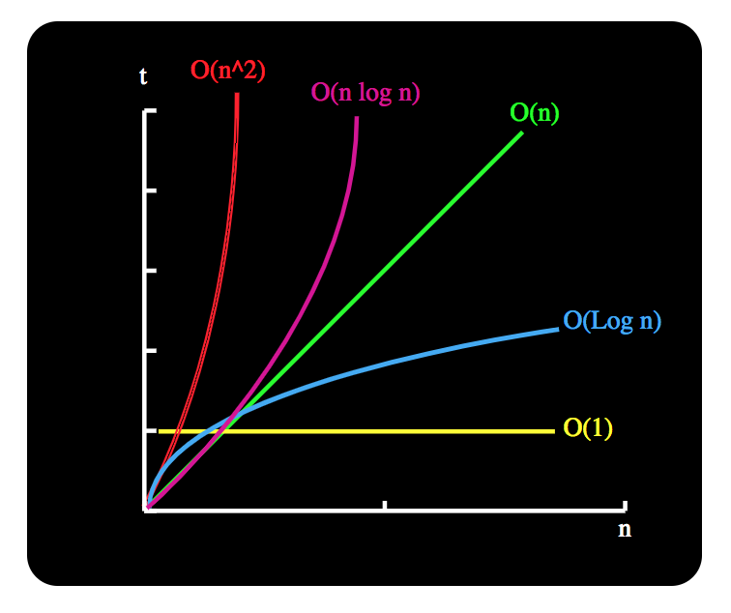
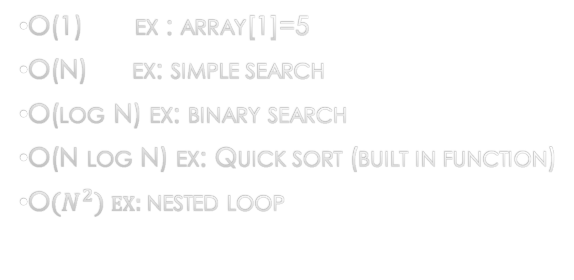
Famous Time complexity
O(1) ex : array[1]=5
O(N) ex: simple search
O(log N) ex: binary search
O(N log N) ex: Quick sort (built in function)
O${(N}^{2}) ex:$nested loop

Slide 7
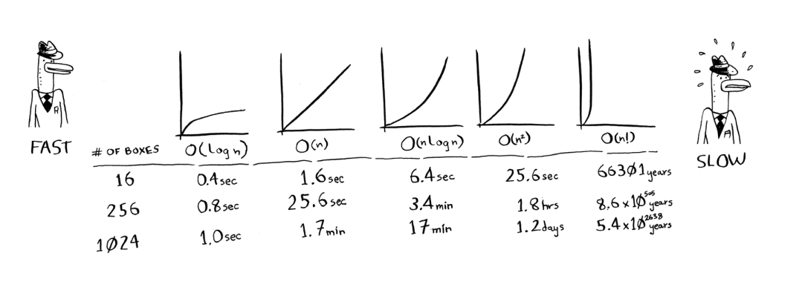
Calc time of solution
10 operation per second

Slide 8
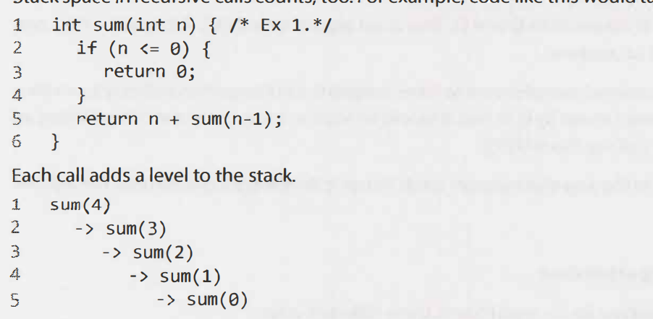
space complexity
Time complexity O(N) Space complexity O(N)

Slide 9
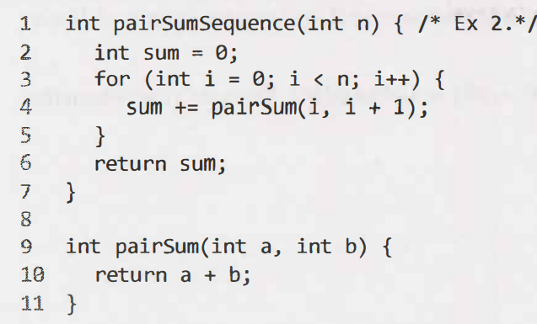
space complexity
Time complexity O(N) Space complexity O(1)

Slide 10
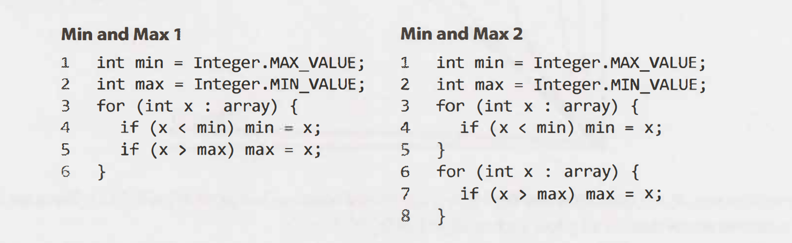
Drop the constant
O( N)
O(N+N)=O(2 N)
Both are O(N)

Slide 11

Drop the Non-Dominant Terms
O($N^{2}$+N) becomes O($N^{2})$
O(N + log N) becomes O(N)
O(5*$2^{N}$+1000* $N^{1000 }) becomes$ o($2^{N}$)

Slide 12
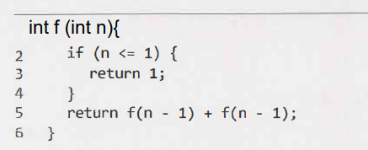
Time of recursive calls

Slide 13
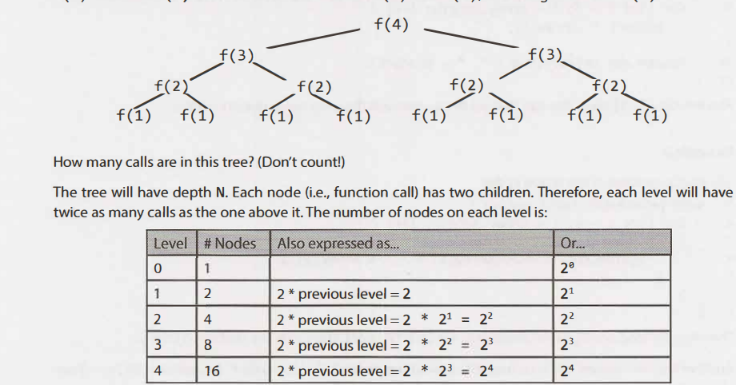
Time of recursive calls
When you have a recursive function that makes multiple calls, the runtime will often (but not always) look like O(${branches}^{depth}$), where branches is the number of times each recursive call branches. In this case, this gives us O ($2^{N}$).

Slide 14
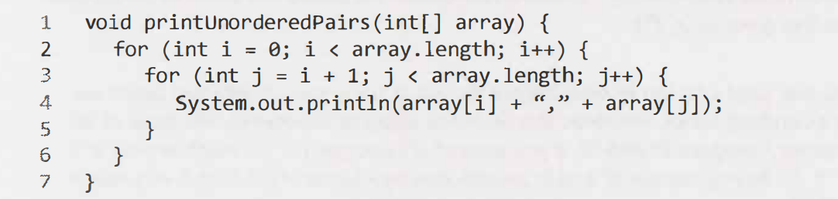

Examples
O($N^{2}$)

Slide 15
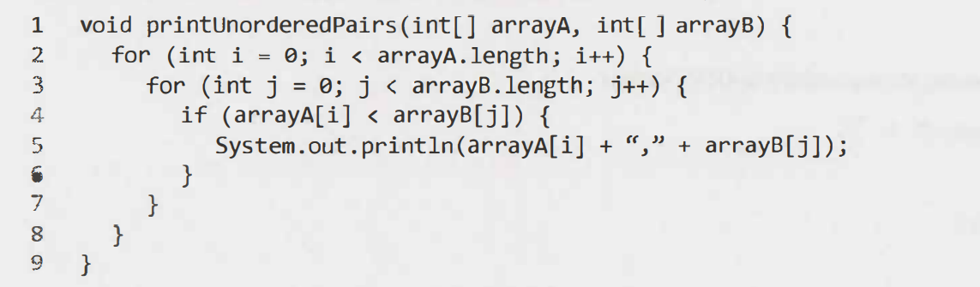
Examples
O(ab)

Slide 16
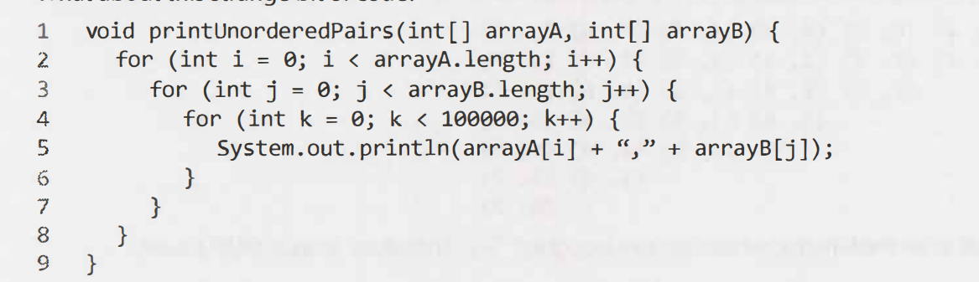
Examples
O(ab)

Slide 17
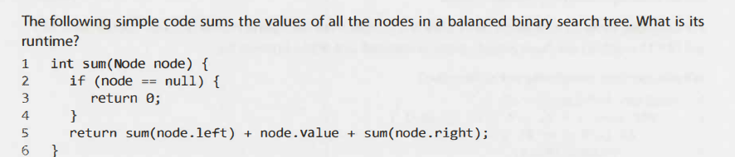
Examples
O(N)

Slide 18
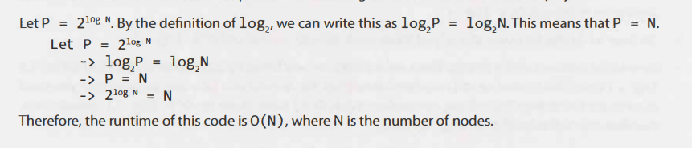
Examples

Slide 19
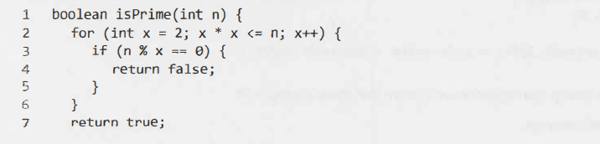
Examples
O(√N)

Slide 20
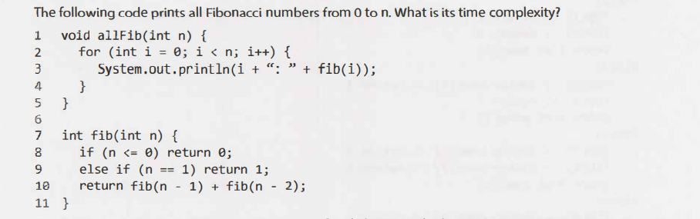

Examples
O($2^{N}$)

Slide 21
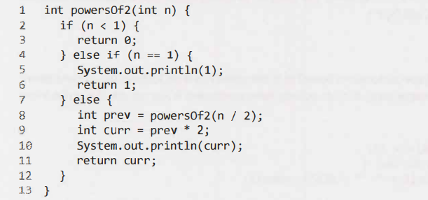
Examples
O(log n)

Slide 22
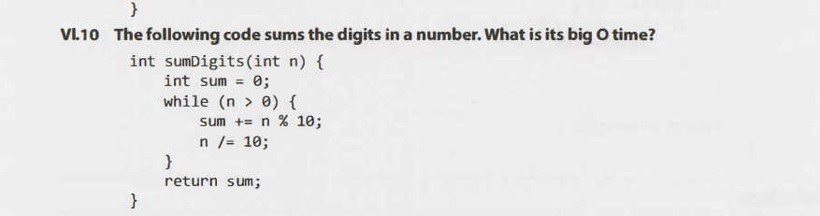
Examples
O(log n)

